Slide 1

2018-2019 NBA Season
Sports Analytics
Chris Park

Slide 2
Season Overview
There were a lot of major events that occurred during the 2018-2019 NBA Season. NBA legends such as Dwyane Wade and Dirk Nowitzki retired, LeBron passed Michael Jordan on the all-time scoring list, and various star players moved to other teams. I thought this season would be interesting to simulate because it had one of the craziest offseason changes, a lot of crucial injuries, breakout players/teams, and LeBron did not make the playoffs. For example, Kawhi went to the Raptors, LeBron went to the Lakers, DeMar DeRozan went to the Spurs, Jimmy Butler went to the 76ers, and Kristaps Porzingis went to the Mavericks. Also, Steph Curry, Kevin Durant, Victor Oladipo, Demarcus Cousins, Jusuf Nurkic, and LeBron James were all injured either for a prolonged amount of time or indefinitely. Other new events were the Bucks breaking out with a 60-win season, the Nuggets winning their first division title in nine seasons, and breakout seasons by new all stars D’Angelo Russell and Nikola Vucevic.

Slide 3
Season Format
Regular Season Format:
This season consisted of two conferences (East and West) and six divisions in total (Atlantic, Central, Southeast, Northwest, Pacific, and Southwest). Also, each division consists of five teams. Lastly, 82 regular season games were played by all the teams.
Playoff Format:
Sixteen teams make the playoffs (eight from each conference) regardless of winning the division because they are seeded by the number of wins. Also, no teams get a bye to the second round of the playoffs.

Slide 4
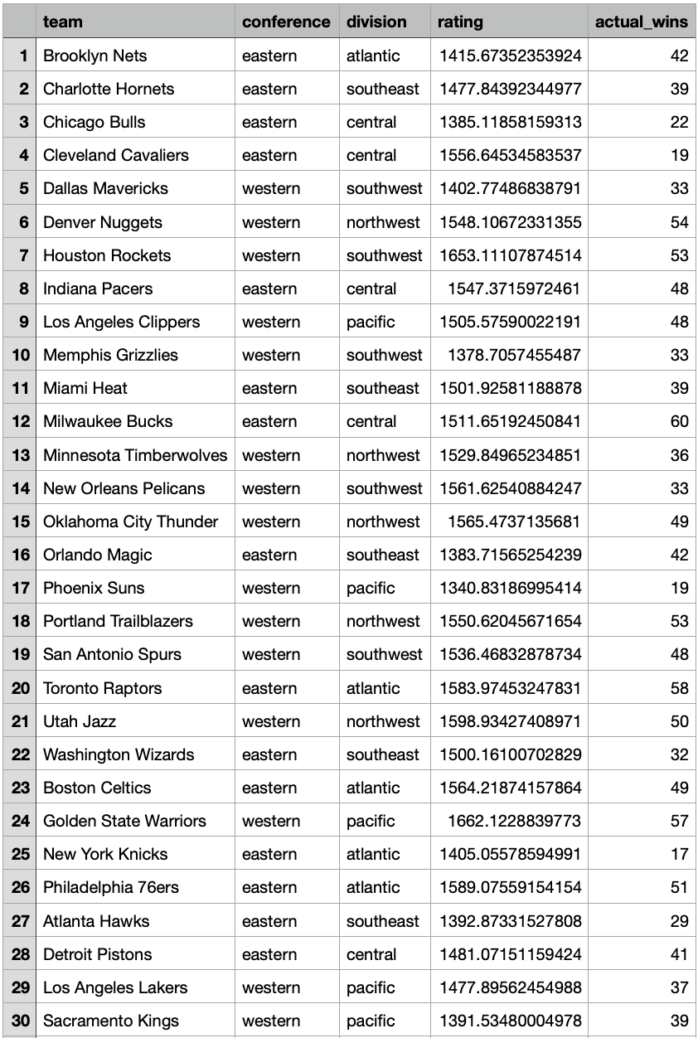
Preseason Elo Ratings
The table of the team’s preseason ratings show team name, conference, division, rating, and actual wins.
The expected division winners are 76ers for the Atlantic, Heat for the Southeast, Cavaliers for the Central, Rockets for the Southwest, Jazz for the Northwest, and Warriors for the Pacific.
The expected playoff teams are the Sixers, Raptors, Celtics, Cavs, Bucks, and Heat for the East and Warriors, Rockets, Jazz, Thunder, Pelicans, Nuggets, Trailblazers, and Spurs for the West.

Slide 5
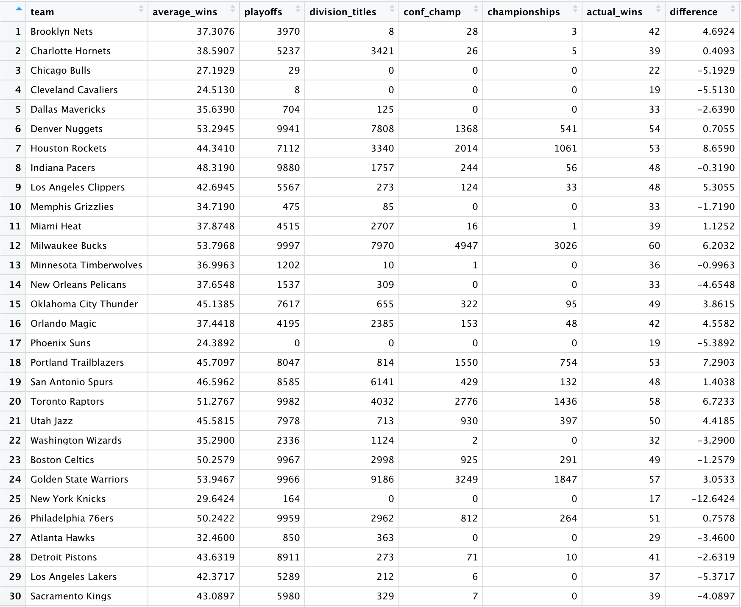
Simulated Regular Season Results
The teams’ average wins is shown in this table which reflects the teams’ performances in the regular season.

Slide 6
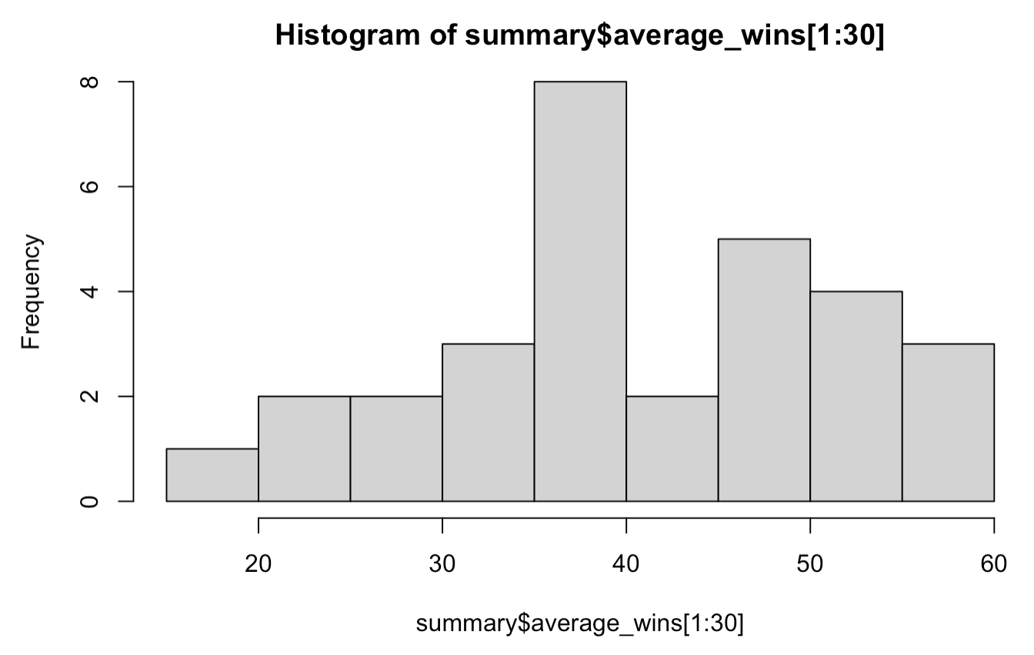
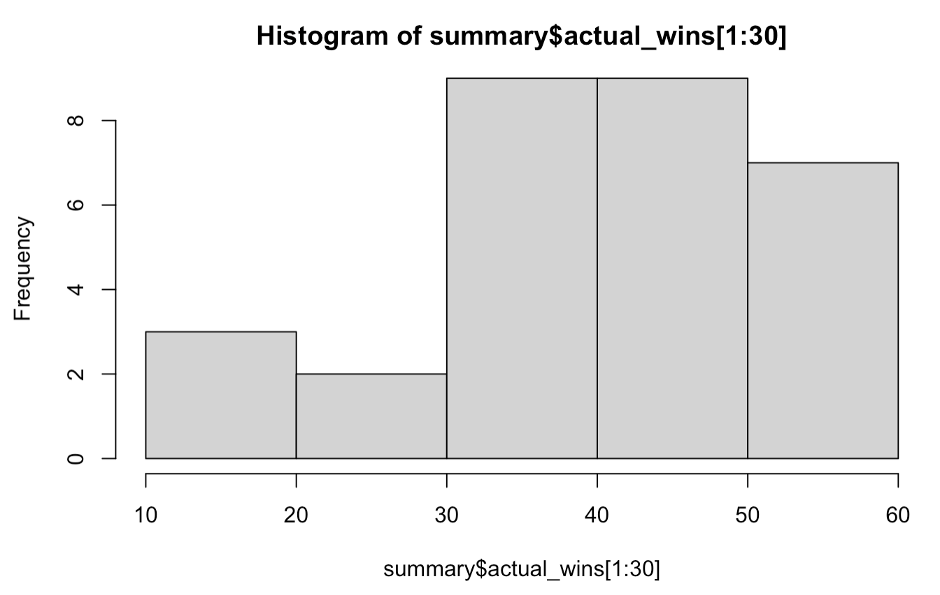
Comparison of Simulated and Actual Regular Seasons
Overall, there were slightly more teams that performed better in real life than in the simulation.

Slide 7
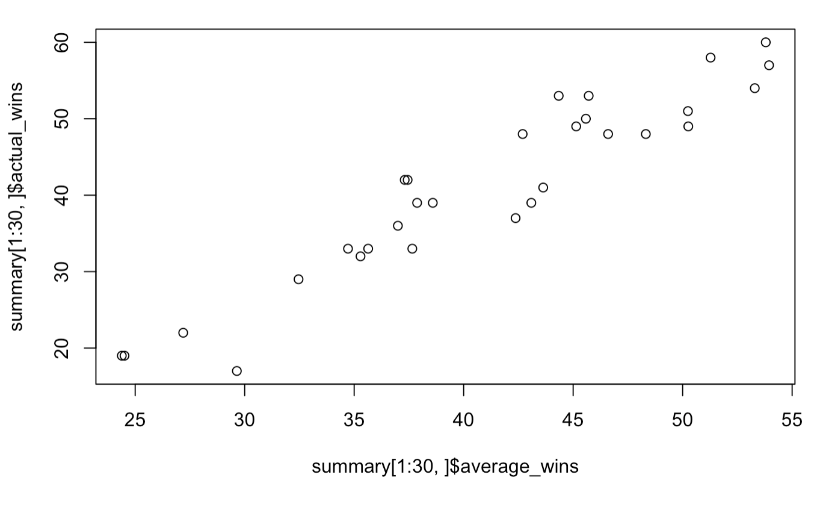
Comparison of Simulated and Actual Regular Seasons
There seems to be a strong positive linear relationship between the actual wins and simulated wins. Also, the correlation between the two is 0.9424123

Slide 8
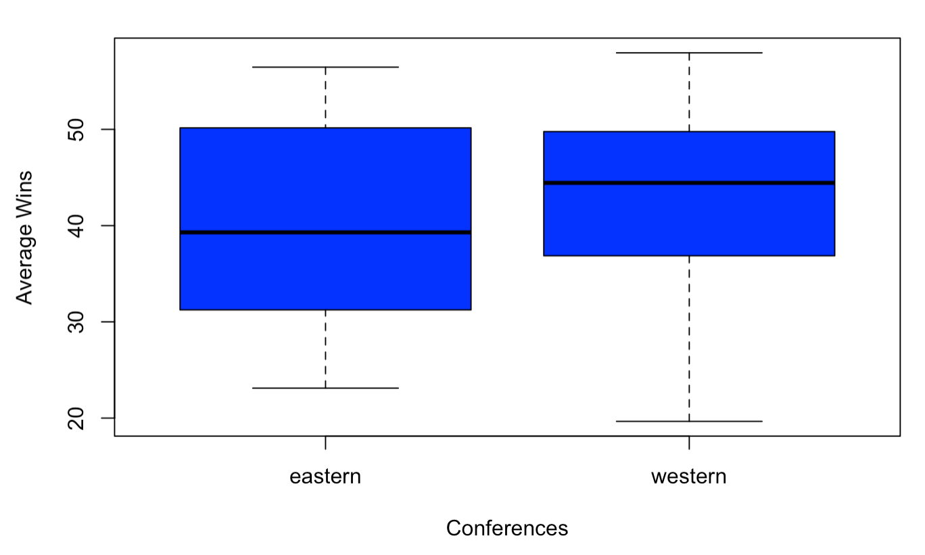
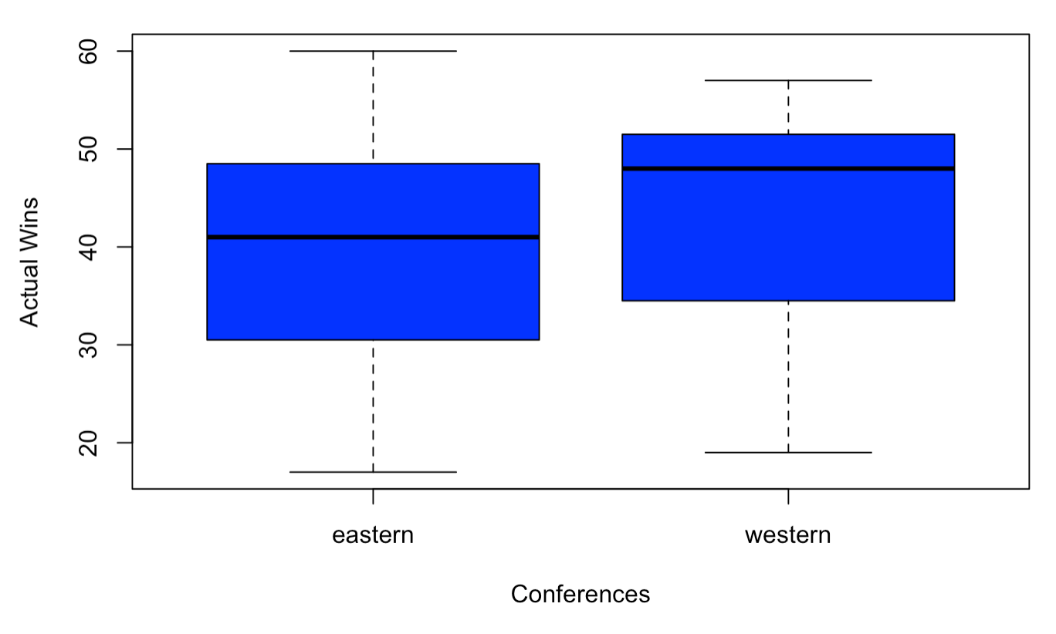
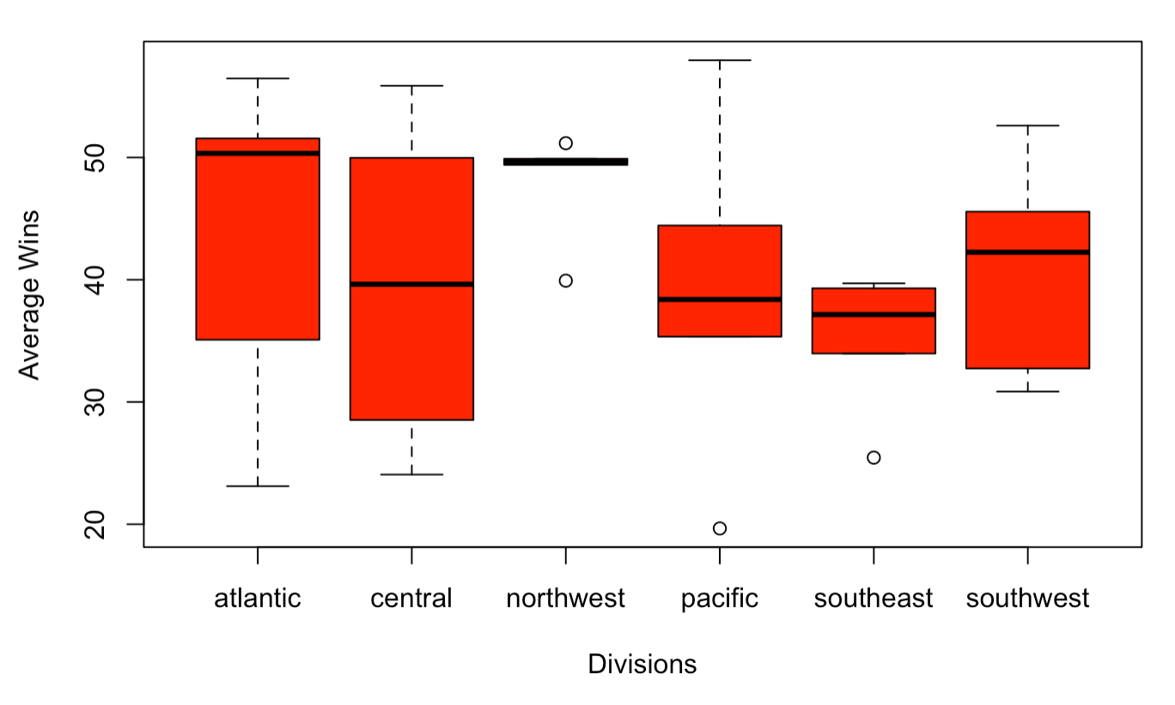
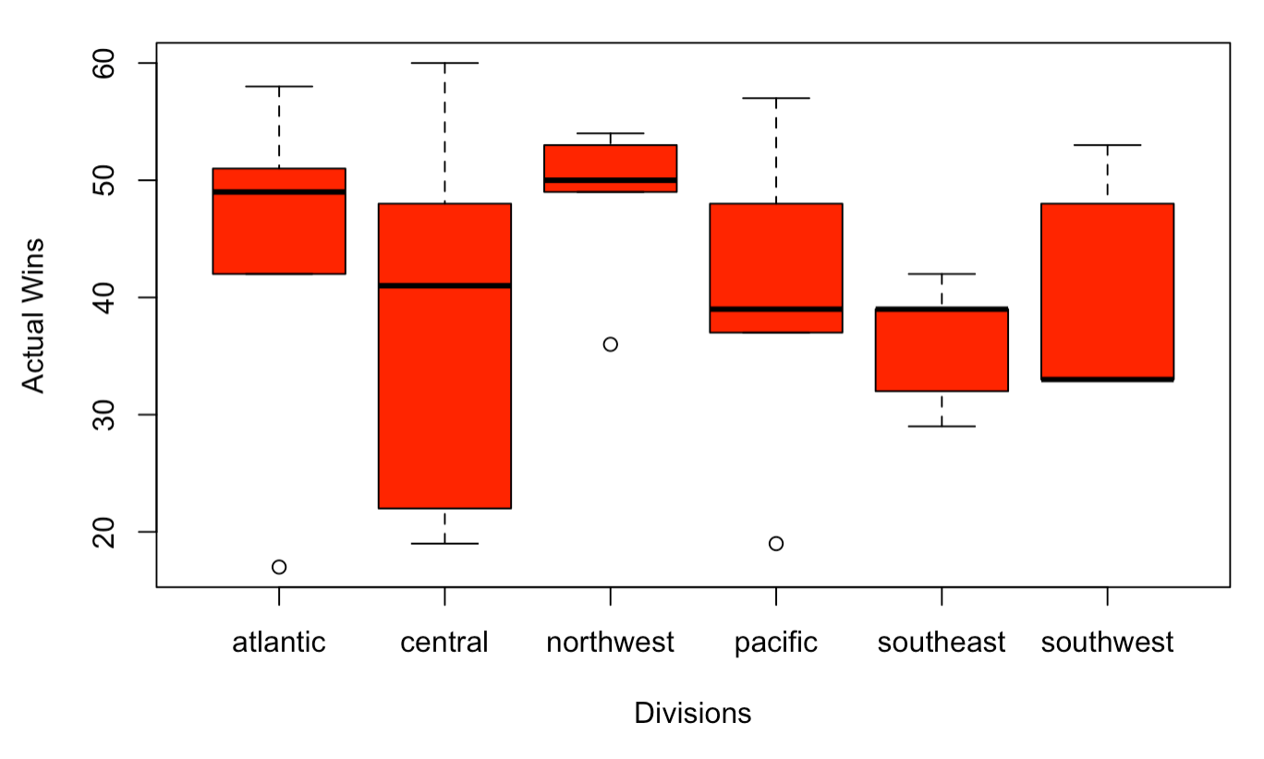
Comparison of Simulated and Actual Regular Seasons
The median of the actual wins in the East is greater than the median of the simulated wins in the East. This is also evident in the West. Comparing the actual wins and simulated wins for each division, there are lots of differences such as the changes in skew and median.

Slide 9
Discussion of Regular Season Results
The teams that performed very close to expectations are the Warriors, Heat, Suns, 76ers, Thunder, Hornets, Mavericks, and Rockets.
The team that won their division but did so infrequently in the simulation was the Orlando Magic. The simulation had three other teams in its division have more division titles.
The Pistons, Magic, and Nets made the playoffs but did so infrequently in the simulation. The Pistons made the playoffs as the last seed in the simulation. Also, it had the Heat and Hornets making the playoffs instead of the Magic and Nets.

Slide 10
Simulated Playoff Results
The teams’ playoff appearances, division titles, championship game appearances, and championships which reflect the teams’ performance in the playoffs are shown in the table.

Slide 11
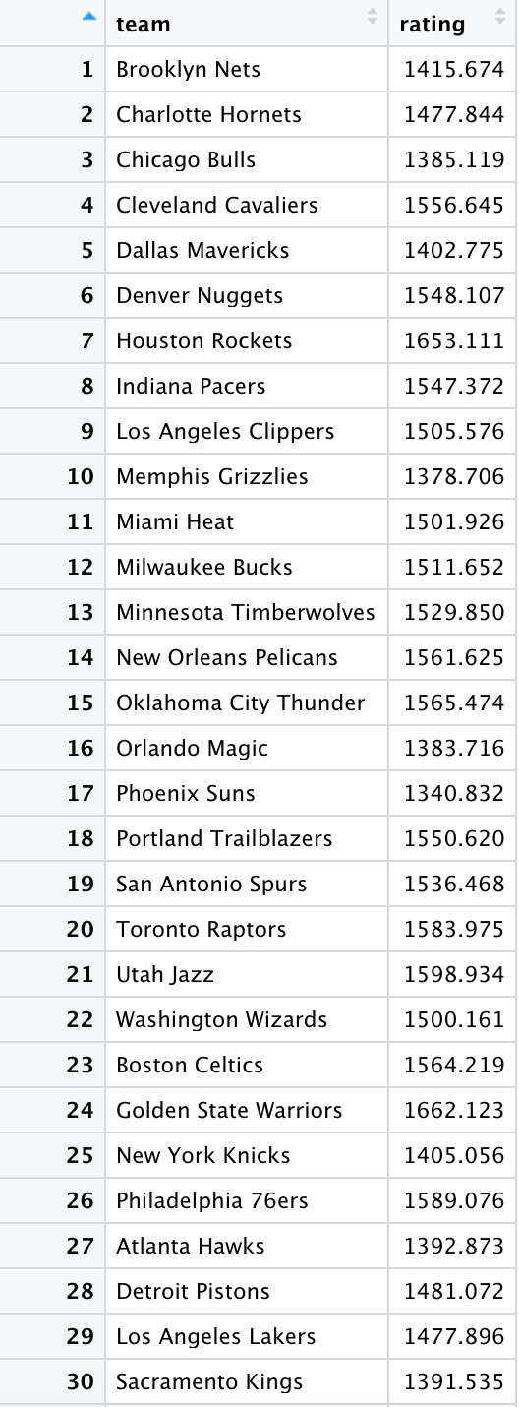

Simulated Playoff Results
On the left are the preseason Elo ratings and on the right are the final season Elo ratings

Slide 12
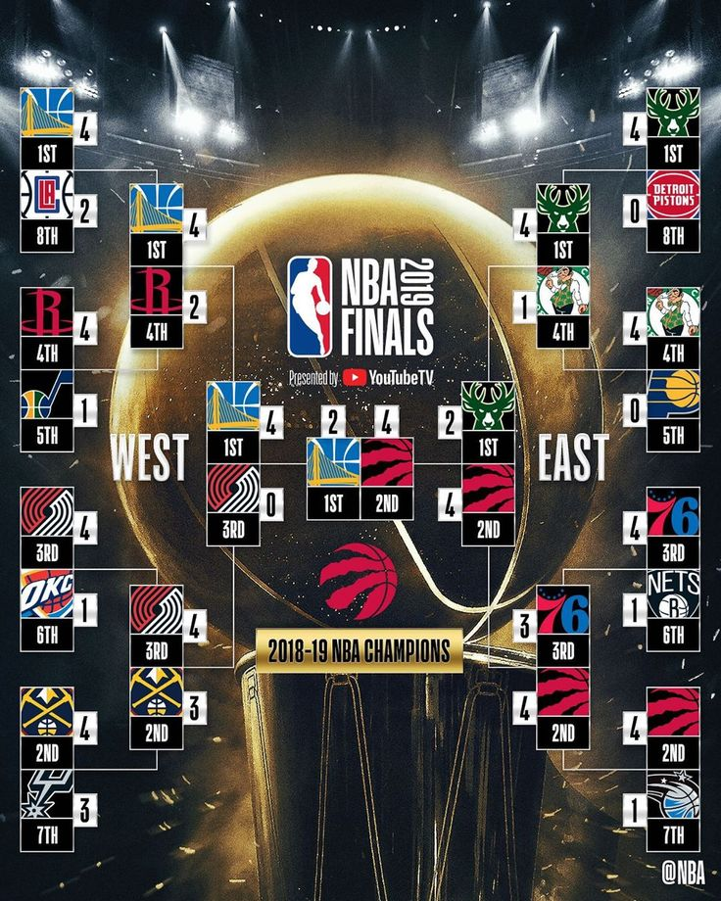
Actual Playoff Bracket

Slide 13
Comparison of Simulated and Actual Playoffs
The Warriors and Raptors performed worse in the simulation playoffs compared to the actual playoffs. In the simulation, both the Rockets and Bucks were the conference champions more than the actual two conference champions. In other words, the Rockets and Bucks performed better than expected in the simulation playoffs compared to the actual playoffs.
The Hornets and Heat performed better than expected in the playoffs in the simulation given that they did not make the actual playoffs.
There were no early upsets or unexpected runs in the actual playoffs that Elo did not project.

Slide 14
Three Teams Overview
The Thunder performed close to expectations
Simulated Wins: 49.3921
Actual Wins: 49
Simulated Playoffs: made the playoffs 9364 times but were conference champions only 316 times and league champions 99 times in the simulation
Actual Playoffs: made it to the playoffs but lost in the first round of playoffs
The Nuggets overachieved
Simulated Wins: 49.8984
Actual Wins: 54
Simulated Playoffs: made the playoffs 9477 times and were conference champions 529 times and league champions 181 times in the simulation
Actual Playoffs: made it to the playoffs but lost in the second round of playoffs
The Pelicans underachieved
Simulated Wins: 42.2500
Actual Wins: 33
Simulated Playoffs: made the playoffs 4260 times but were conference champions 0 times in the simulation
Actual Playoffs: did not make the playoffs

Slide 15
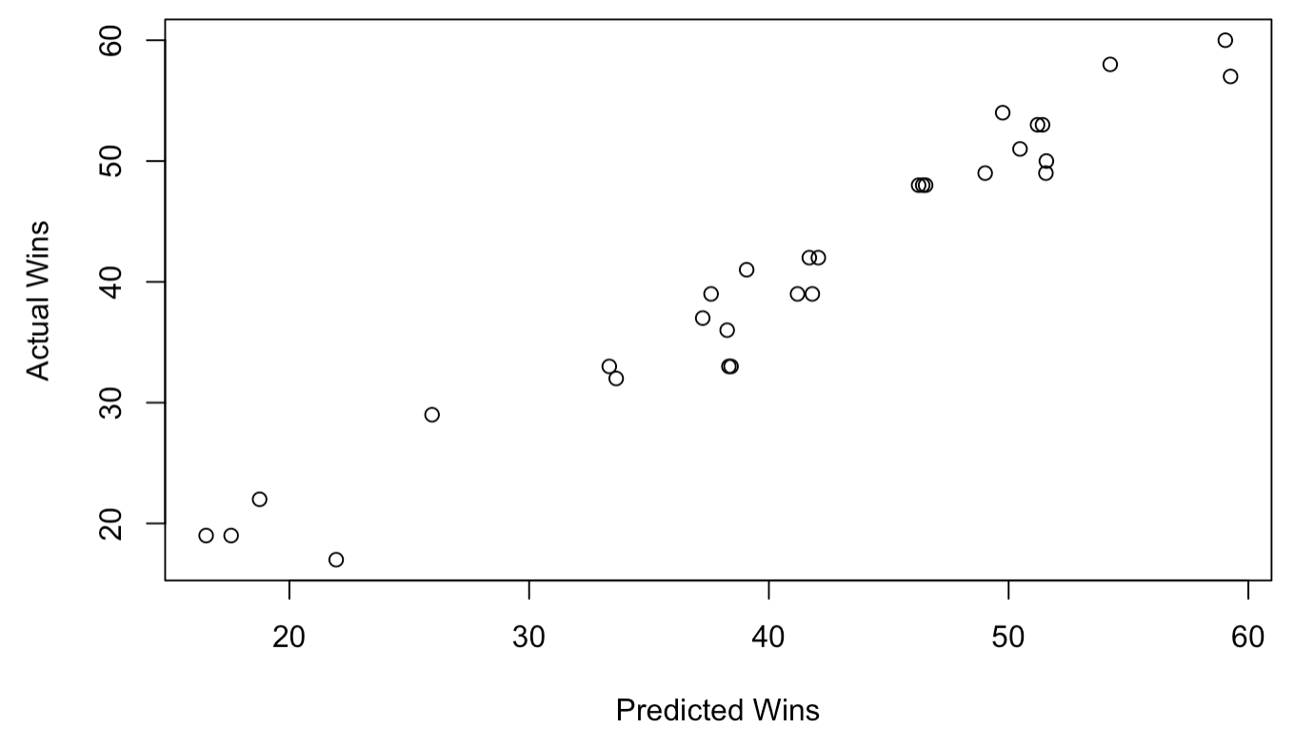
Relevant Statistics
A model using the four factors in basketball was used to predict win totals so that it could be compared against the simulated win total.
The relationship between the actual number of wins and predicted number of wins is strong, positive, and linear. The correlation between the two is 0.9761532.

Slide 16
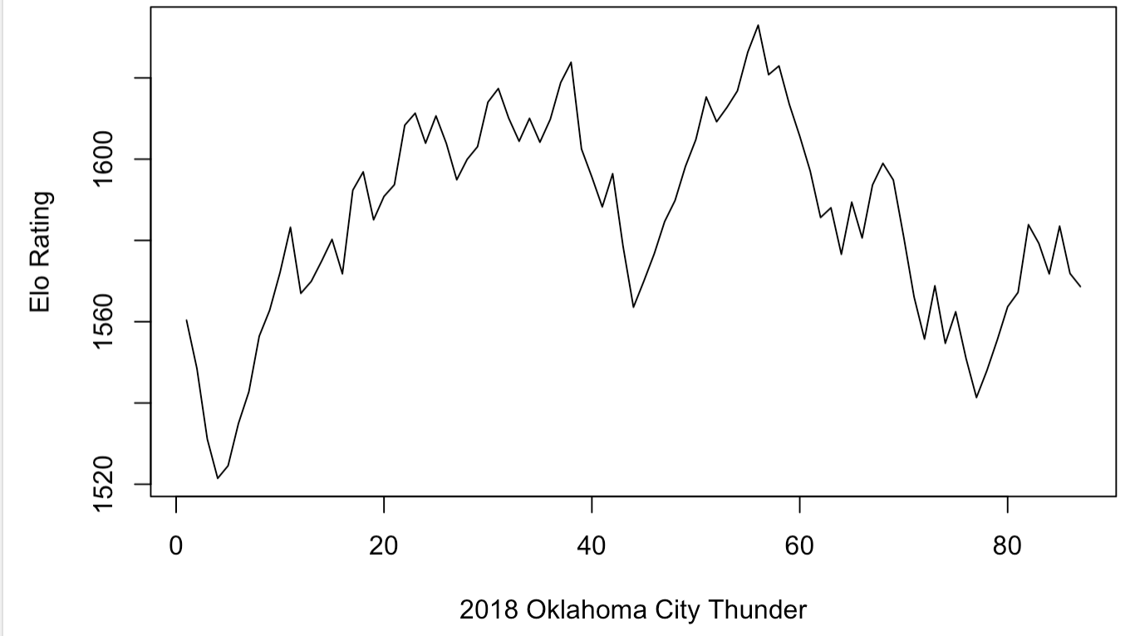
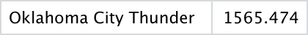
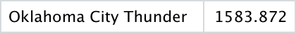
Analysis of Average Team
The Thunder’s Elo rating fluctuated throughout the season but ended up finishing with a rating similar to its pre-season Elo rating.

Slide 17
Analysis of Average Team
From the relevant statistics before (four factors model), the Thunder’s predicted wins according to the model was 49.02223. They recorded 49 wins in the actual season which is 0.02223 less games than predicted.
Given that the Elo rating stayed similar from the beginning and end of the season and that the predictions were very close to the actual results, it can be assumed that the Thunder were an average team in the 2018-2019 season.

Slide 18
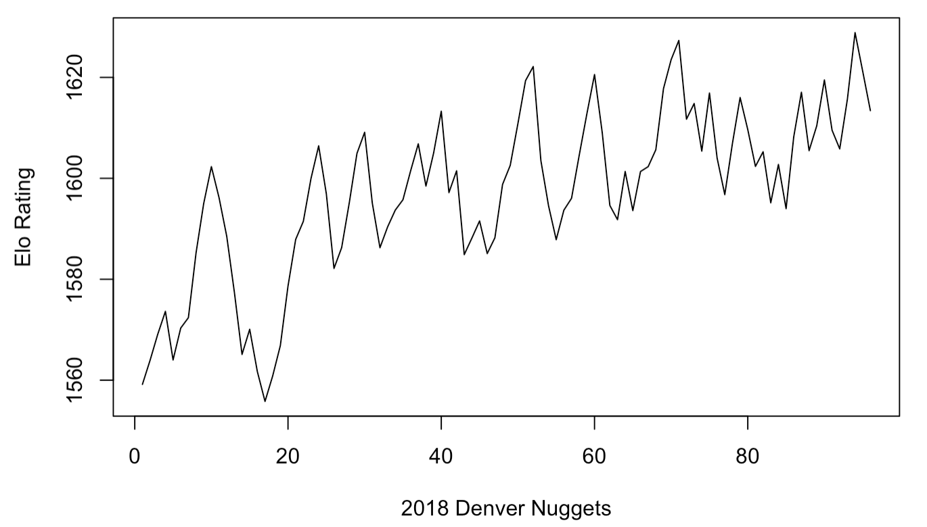
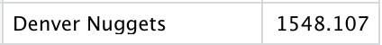
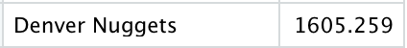
Analysis of Overachieving Team
The Nugget’s Elo rating looks like it increased through out the season and ended with a rating significantly higher than its pre-season Elo rating.

Slide 19
Analysis of Overachieving Team
From the relevant statistics before (four factors model), the Nugget’s predicted wins according to the model was 49.75337. They recorded 54 wins in the actual season which is 4.24663 more games than predicted.
Given that the Elo rating increased from the beginning and end of the season and that the actual win total was significantly greater than the prediction win total, it can be assumed that the Nuggets were an overachieving team in the 2018-2019 season.

Slide 20
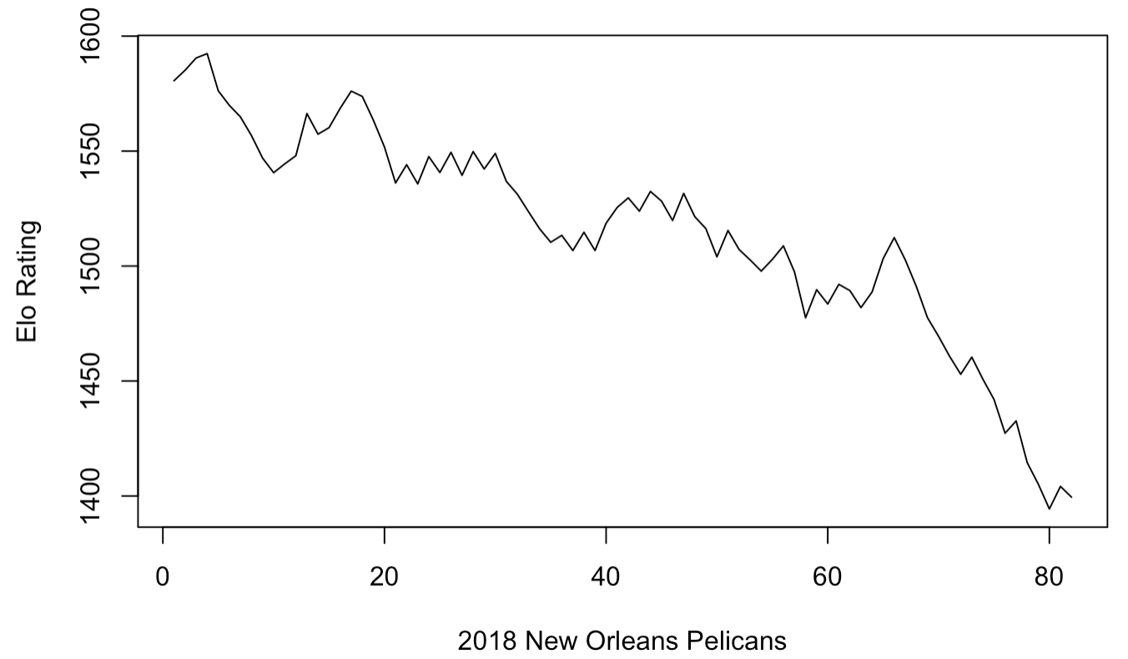
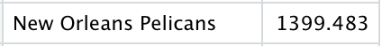
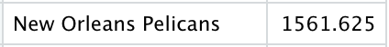
Analysis of Underachieving Team
The Pelican’s Elo rating looks like it decreased through out in the season and ended with a rating significantly lower than its preseason Elo rating.

Slide 21
Analysis of Underachieving Team
From the relevant statistics before (four factors model), the Pelican’s predicted wins according to the model was 38.42273. They recorded 33 wins in the actual season which is 5.42273 less games than predicted.
Given that the Elo rating decreased from the beginning and end of the season and that the actual win total was significantly less than the predicted win total, it can be assumed that the Pelicans were an underachieving team in the 2018-2019 season.

Slide 22
Conclusions/Takeaways
The 2018-2019 NBA Season was full of major events with key injuries, players getting traded to different teams, and breakout performances from certain teams and players. Overall, the simulation did a decent job of predicting teams’ performances which can be seen by the correlation between actual wins and simulated wins (0.9424123). However, this value was lower than the simulation of the 2015-2016 NBA Season we did in class which shows that the 2018-2019 NBA Season was more unpredictable. Also, it was obvious that predicting playoffs were more difficult. For example, the simulation had the Bucks winning almost 1000 more times than the Raptors which were the actual champions. However, there were also teams that met expectations and teams that exceeded expectations which were explained by using other relevant statistics such as the four factors model.

